Slide 1
Data clustering with k-means algorithm
Student’s name: thien quoc Nguyen
Applying program: information technology – master
Date: 21-08-2022

Slide 2
Table of contents
Machine Learning
Introduction
Supervised & Unsupervised learning
Project Description
Problem definition
Introduction to K-means algorithm
Installation & Testing
Clustering on Simulation data
Customers clustering using K-means
Conclusion
Evaluation methods and Applications

Slide 3


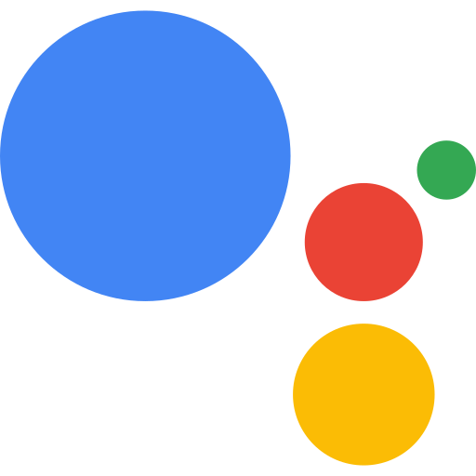


Machine learning > introduction
Notes:
Artificial Intelligence (AI) is creeping into every area of life that we may not realize in recent years:
You can see Self-driving cars from Google and Tesla
Or something you uses everyday like Apple’s Siri Virual Assistant, or if you are Team Google it is Google Assistant or Alexa.
Or something have made into history like Google Deepmind team with AlphaGo had beaten Korean’s world champion Lee Sedol
Those are just a few of the many applications of AI/Machine Learning.

Slide 4
Machine learning > introduction
Computer Program
Experience
E
Performance
P
Tasks
T
Improved
Learned
Notes:
In 1959, Arthur Samuel described it this way: "the field of study that gives computers the ability to learn without being explicitly programmed". That's an old definition.
Then in 1997, Tom Mitchell, a famous professor at Carnegie Mellon University - CMU defined more modern and standard as follows: ”A computer program is said to learn from experience E with respect to some class of tasks T and performance measure P if its performance at tasks in T, as measured by P, improves with experience E”. An example: playing chess:
E: experience in playing many chess games
T: task to play chess
P: performance calculating from T if it improves with E

Slide 5
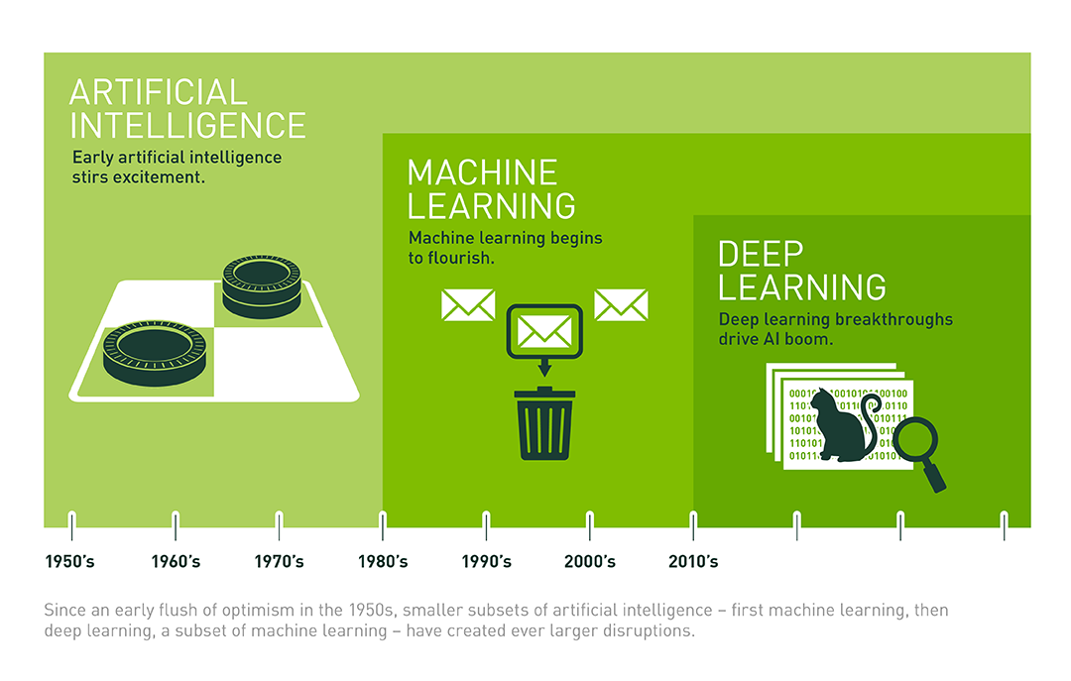
Machine learning > introduction
Notes:
Simply put, Machine Learning is a subfield of Computer Science that has the ability to learn on its own based on input without having to be specifically programmed. In recent years, when the computing power of computers has been raised to a new level with huge amounts of data collected by big technology firms, Machine Learning has come a long way and a new field was born: Deep Learning.
Deep Learning has helped humans do things that were impossible a decade ago: classify thousands of different objects in photos, create labels for images, imitate human voices and handwriting, or even compose music.
Any Machine Learning problem can be assigned to two broad categories: Supervised learning and Unsupervised learning.

Slide 6
Machine learning > categories
Supervised Learning
Unsupervised Learning
Requires labelled input and output data during the training phase
Human involved
Classify unseen data into established categories
Forecast trends and future change as a predictive model.
Unlabelled and raw input
Without Human
Identify patterns and trends in raw datasets
Cluster similar data into a specific number of groups
Suited to answer questions about unseen trends and relationships within data itself
Notes:
Supervised machine learning requires labelled input and output data during the training phase. This training data is often labelled by a data scientist in the preparation phase, before being used to train and test the model. Once the model has learned the relationship between the input and output data, it can be used to classify new and unseen datasets and predict outcomes.
The reason it is called supervised machine learning is because at least part of this approach requires human oversight. The vast majority of available data is unlabelled, raw data. Human interaction is generally required to accurately label data ready for supervised learning. Naturally, this can be a resource intensive process, as large arrays of accurately labelled training data is needed.
By learning patterns between input and output data, supervised machine learning models can predict outcomes from new and unseen data. This could be in forecasting changes in house prices or customer purchase trends.
Unsupervised machine learning is the training of models on raw and unlabelled training data. It is often used to identify patterns and trends in raw datasets, or to cluster similar data into a specific number of groups. It’s also often an approach used in the early exploratory phase to better understand the datasets.
As the name suggests, unsupervised machine learning is more of a hands-off approach compared to supervised machine learning. A human will set model hyper-parameters such as the number of cluster points, but the model will process huge arrays of data effectively and without human oversight.
By grouping data along similar features or analysing datasets for underlying patterns, unsupervised learning is a powerful tool used to gain insight from this data. therefore suited to answer questions about unseen trends and relationships within data itself.
In contrast, supervised machine learning can be resource intensive because of the need for labelled data.

Slide 7

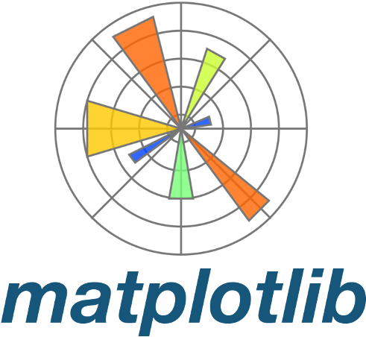

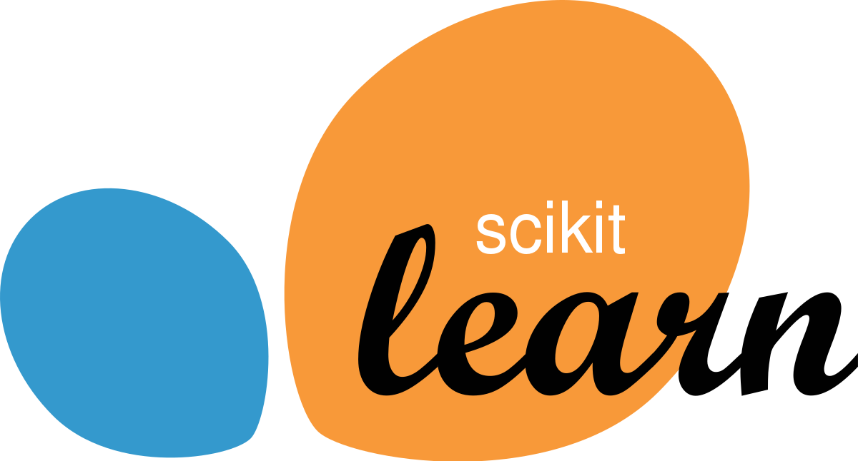
Machine learning > common libraries
Notes:
Numpy: provides objects and methods for working with multi-dimensional arrays and linear algebra operations.
Pandas: an open source library, effectively supporting data manipulation. It is also a powerful data processing and analysis toolkit of the python programming language. This library is widely used in both research and development of data science applications as it uses a separate data structure, Dataframe. Pandas provides a lot of functionality for handling and working on this data structure.
Scikit-learn (abbreviated as sklearn): an open source library for machine learning - a branch of artificial intelligence, very powerful and popular with the Python community, designed on top of NumPy and SciPy. Scikit-learn contains most of the most modern machine learning algorithms, accompanied by documentations, always up to date.
Matplotlib: is a set of functions that matplotlib can work with as MATLAB. Each pyplot function makes a change in the graph, for example creating a plot frame, plotting on the created frame, or plotting multiple lines on the same graph, labeling the axes, etc. The various states in matplotlib.pyplot store the called functions, which save everything of the current graph and plotted plot area, and the graph function plotted directly on the coordinate axes.

Slide 8
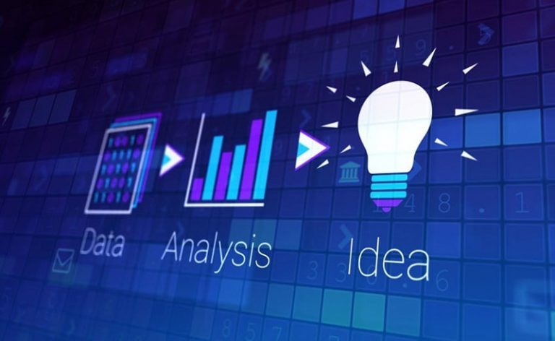

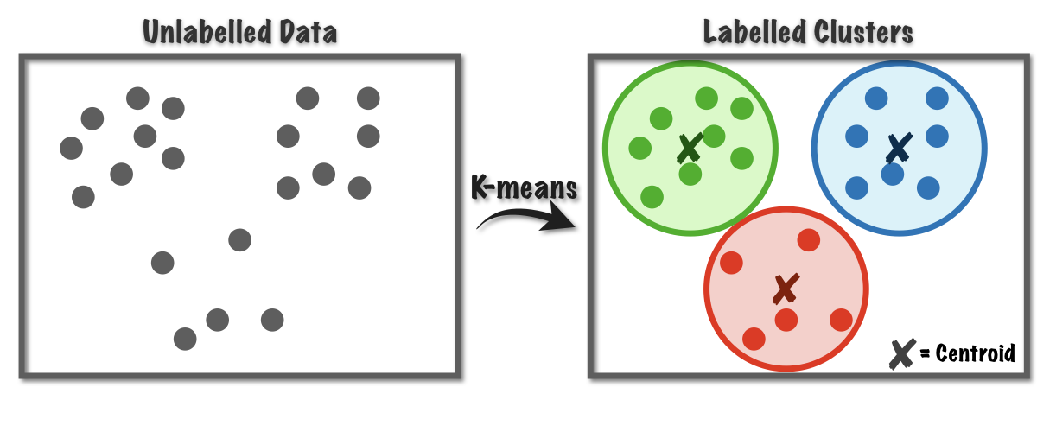
Project description > problem definition
Notes:
The trend of today's world, data is becoming more and more expansive. Humans do not have enough human resources to analyze and categorize this massive “data block”. There are many ways to extract information from data, one of which is clustering. Clustering is often used to analyze data that has large or even very large data in terms of numbers and labels on unknown data. Since labeling large amounts of data is a costly and time-consuming task, we need to find a different approach, which is necessary to extract useful information from the data. Clustering focuses on finding methods for efficient and effective cluster analysis in large databases.
In clustering, it is often necessary to define several centers of the cluster in advance to ensure that the sum of squared errors between each data point and its potential centers is small during clustering. In this project, a data clustering software using K-means clustering algorithm is one of the solutions being applied in many fields around the world.

Slide 9
Project description > introduction to k-means
Unlabeled data X
Number of clusters K to find
M centers and labels vector for each data point Y
Step 2
Step 1
Step 3
Step 4
Step 5
Choose center m for each cluster k
Assign each data point x to closest center m
If the assignment of data to each cluster k does not change. Stop and extract result
Update center m for each cluster k by calculating the mean of all data points of that cluster
Go back to Step 2
Notes:
In the implementation of the data clustering algorithm, MacQueen introduced the K-means algorithm in his paper in 1967^{[10]}: K-means clustering is a form of Unsupervised Learning, used when you have unlabeled data (i.e., data with no categories or undefined groups). The purpose of this algorithm is to find groups in the data, with the number of groups represented by the variable K. The algorithm works iteratively to assign each data point to one of the K groups based on the features provided. The data points are clustered based on feature similarity. The result of the algorithm means:
-The centers of the clusters K can be used to label new data.
-Label for training data (each data point is assigned to a unique cluster).
Brief description of the algorithm steps ^{[11]}:
Input: Unlabeled data X and the number of clusters K to find.
Output: M centers and label vectors for each data point Y.
Step 1: Choose any K points as initial centers. The center can be initialized randomly or choose any point on the data to be the initial center.
Step 2: Assign each data point to the cluster whose center is closest to it. For each data point, we calculate its distance to the centers (by Euclidean Distance). We will assign them to the nearest center. The set of points assigned to the same center will form a cluster.
Step 3: If the assignment of data to each cluster in step 2 does not change compared to the previous loop, then we stop the algorithm.
Step 4: Update the center for each cluster by calculating the mean of all data points assigned to that cluster after step 2.
Step 5: Go back to step 2.

Slide 10
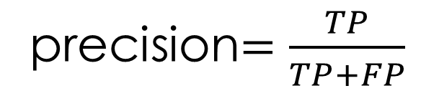
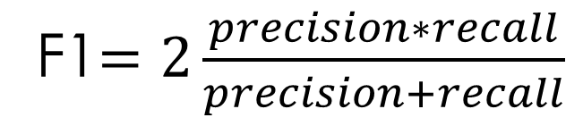
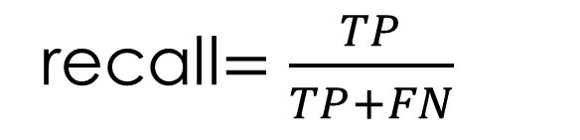
Project description > evaluation methods & application
F1 Score
Precision
Recall
recall$=\frac{TP}{TP+FN}$
Reality Prediction | Positive | Negative
Positive | TP | FP
Negative | FN | TN
precision$=\frac{TP}{TP+FP}$
F1$=2\frac{precision∗recall}{precision+recall}$
precision | recall | F1
1 | 1 | 1
0.1 | 0.1 | 0.1
0.5 | 0.5 | 0.5
1 | 0.1 | 0.182
0.3 | 0.8 | 0.36
Notes:
The purpose of clustering is to find out the inner nature of groups of data. It generates clusters. However, there is no single best criterion for evaluating the effectiveness of clustering analysis, this depends on the purpose of clustering such as: data reduction, “natural clusters”, “useful” clusters, outlier detection…^{[11]}
Clustering techniques can be applied in many fields such as^{[11]}:
-Marketing: Identify customer groups (potential customers, value customers, classify and predict customer behavior, etc.) that use the company's products or services to help the company build an effective business strategy.
-Biology: Grouping animals and plants based on their properties.
-Library: Track readers, books, predict readers' needs...
Insurance, finance: Grouping users of insurance and financial services, predicting trends of customers, detecting financial frauds.
-WWW: Categorize documents, classify web users…
Education: Classify students, evaluate students' academic performance based on scores to orient the exam block for students...
There are many ways to evaluate the quality of clustering, depending on the different problems that we use different methods. The commonly used methods are^{[11]}: accuracy score, confusion matrix, ROC curve, Area Under the Curve, Precision and Recall, F1 score, Top R error, etc. This project will use F1 score for evaluation.
F1 score is a harmonic mean of Precision and Recall^{[12]}. With a way of identifying a class as positive, Precision is defined as the ratio of true positive scores among those classified as positive (TP + FP). Recall is defined as the ratio of the number of true positives among those that are actually positive (TP + FN).
If 2 data point in reality/true_lbl are positive(matched)/negative(not matched), and 2 data point in learned_lbl also are => TP, TN
If 2 data point in learned_lbl are not => FP, FN
High precision means that the accuracy of the points found is high. High Recall means high True Positive Rate, which means that the rate of missing really positive points is low.
When Precision = 1, all the points found are really positive, that is, there are no negative points mixed into the results. However, Precision = 1 does not guarantee that the model is good, as the question is whether the model has found all the positives. If a model finds only one positive point that it is most certain about, then we cannot call it a good model.
When Recall = 1, every positive is found. However, this quantity does not measure how many negatives are mixed in. If the model classifies every point as positive, then surely Recall = 1, but it is easy to see that this is an extremely bad model.
Thus, a classifier with precision = recall = 0.5 is better than another classifier with precision = 0.3, recall = 0.8 in this measure.

Slide 11
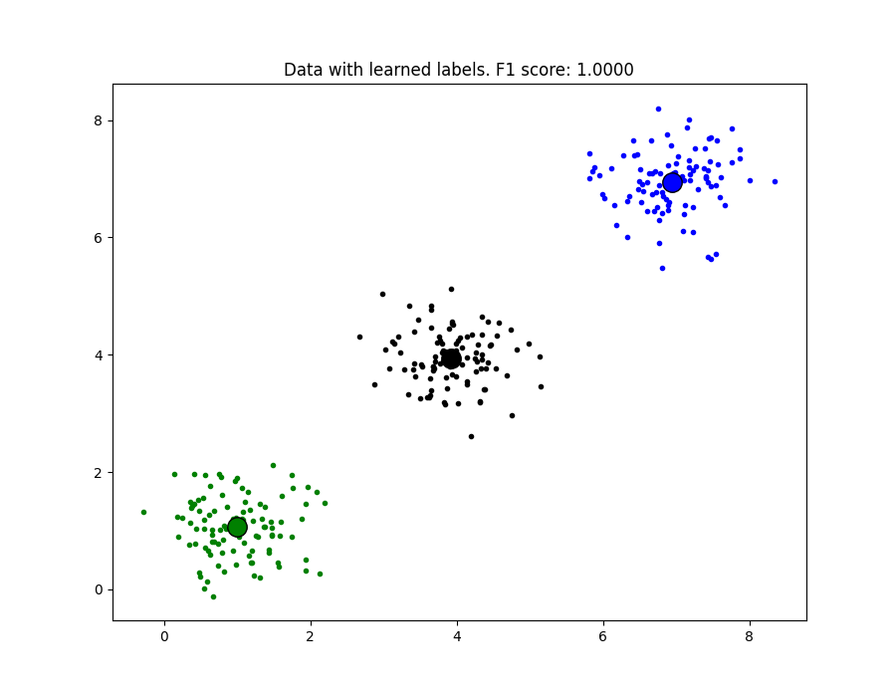
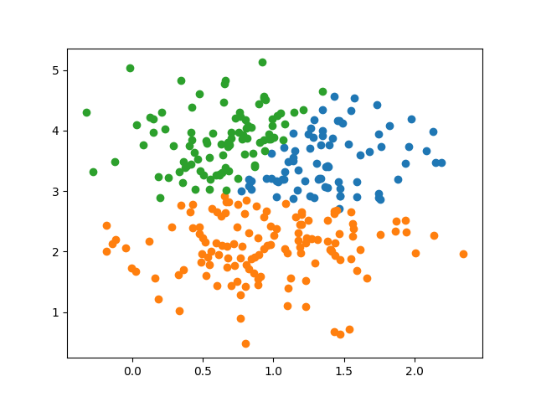
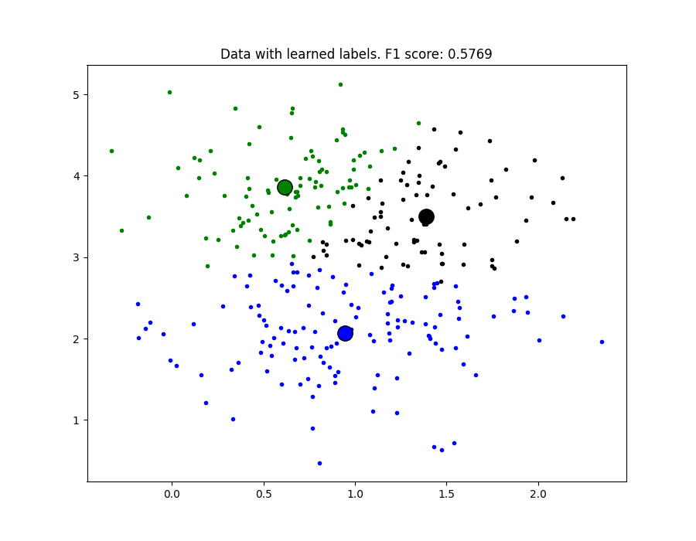
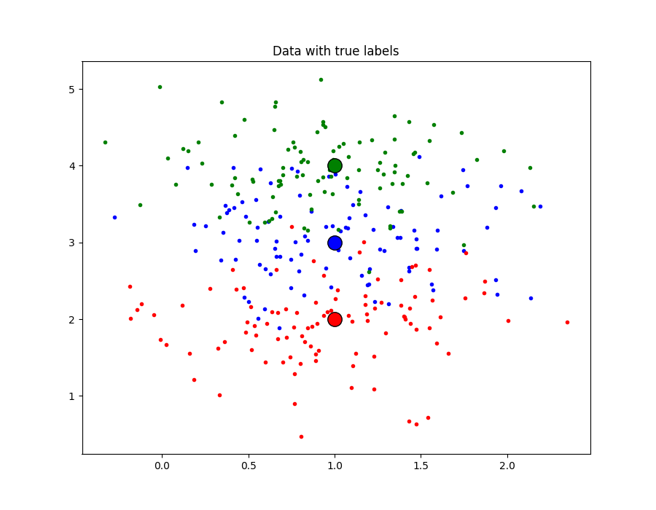
Installation and testing > Simulation Data
Separate data point
Overlapped data point
Notes:
With 2-dimensional point data (x, y), which are separate clusters of points, when running with the K-means algorithm, we can see 100% accurate results through determining F1 score = 1
For overlapping data, the algorithm will not run efficiently. The efficiency of the algorithm will be inversely proportional to the overlap of data clusters. The more overlap, the lower the efficiency.

Slide 12
Notes:
And when I ran the overlapping simulation data, I noticed that the F1 score changed when I rerun the algorithm a few times. That's because initially when running the algorithm, centers are initialized randomly or choose a random point on the data as the initial center, and when the initial center is initialized close to its sample cluster, F1 score will be high. Otherwise, the F1 score will be low, or even the cluster will have no data points.
As you can see in the 2 middle images, the F1 score is higher than the 2 sides when their initial centers are initialized close to the sample center
While the two figures on the right, the initial centers are initialized far away, or deviated to another cluster
the performance of the clustering algorithm is highly dependent on the initialization of the cluster center at the beginning of the algorithm. ^{[15]}One simple solution is just to run K-Means a couple of times with random initial assignments. We can then select the best result by taking the one with the minimal sum of distances from each point to its cluster

Slide 13
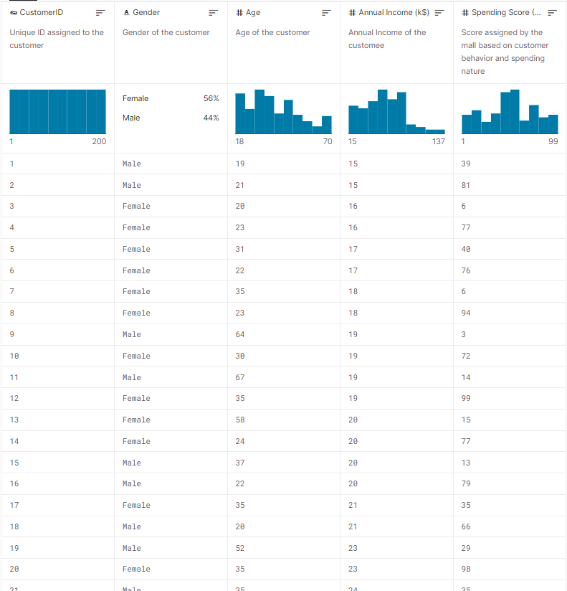
Installation and testing > Customers Data
Content
You are owing a supermarket mall and through membership cards , you have some basic data about your customers like Customer ID, age, gender, annual income and spending score.
Spending Score is something you assign to the customer based on your defined parameters like customer behavior and purchasing data.
Problem Statement
You own the mall and want to understand the customers like who can be easily converge [Target Customers] so that the sense can be given to marketing team and plan the strategy accordingly.
Notes:
Dataset is collected on kaggle^{[13]}: Suppose you own a store, through a customer's membership card, you have some customer information like: Customer ID, Age, Gender, monthly income and spending score at the shop. Classify customers based on those characteristics to be able to understand customer groups or plan a reasonable strategy based on that customer group.
Dataset includes 200 customers. Since this data has not been labeled, it is not possible to compare the performance of the algorithm. This report will be based on the label that the algorithm learns and compare with the label that sklearn's K-means algorithm to compare the output.
Data needs to be preprocessed: remove the header and the customerID column because these fields can affect the clustering ability of the algorithm, causing undesirable results. Also, if there is any feature with distinct "unit", we should remove to reduce the dispersion of data. For this run, the K will be set at 3 clusters.

Slide 14
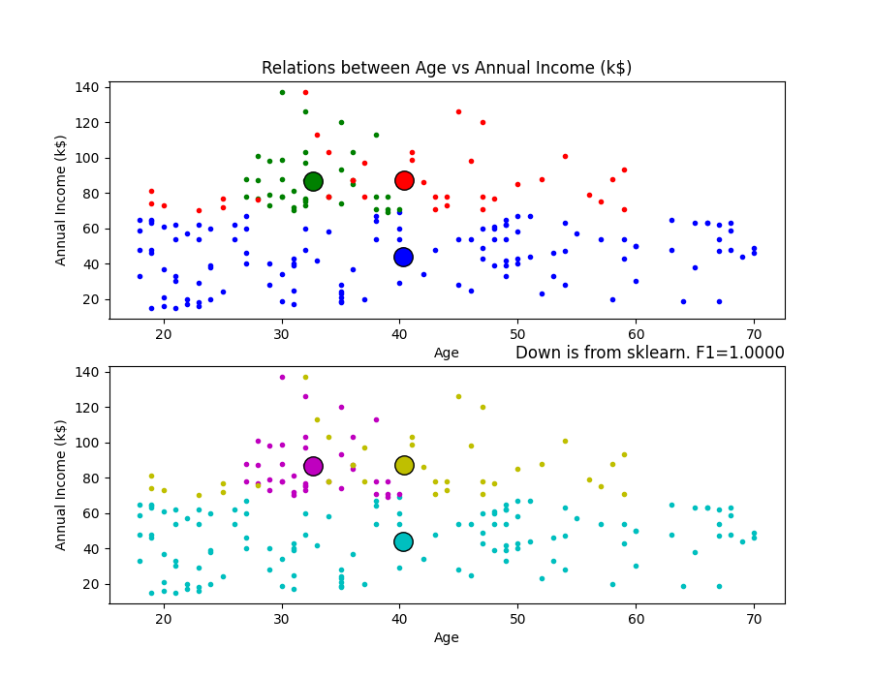
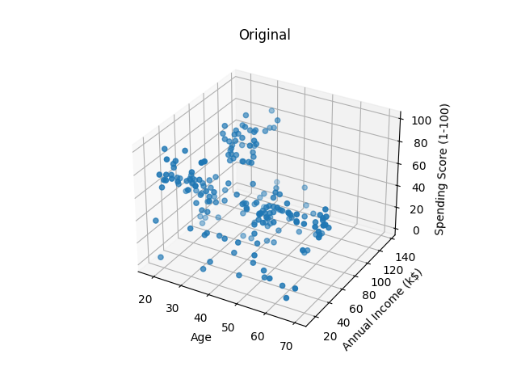
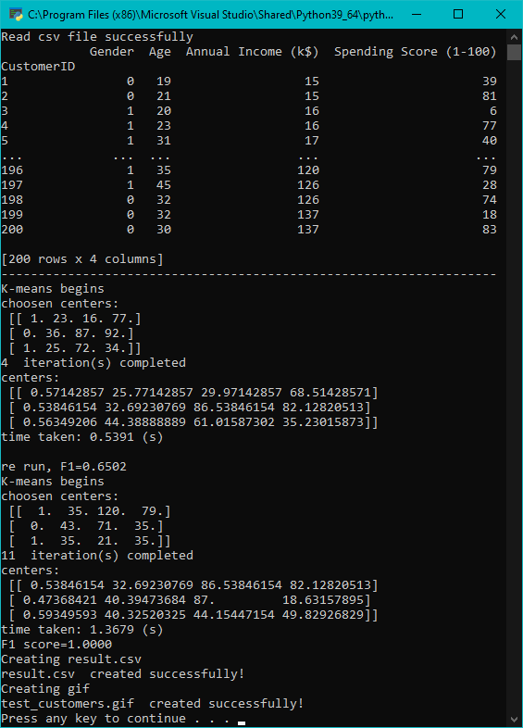
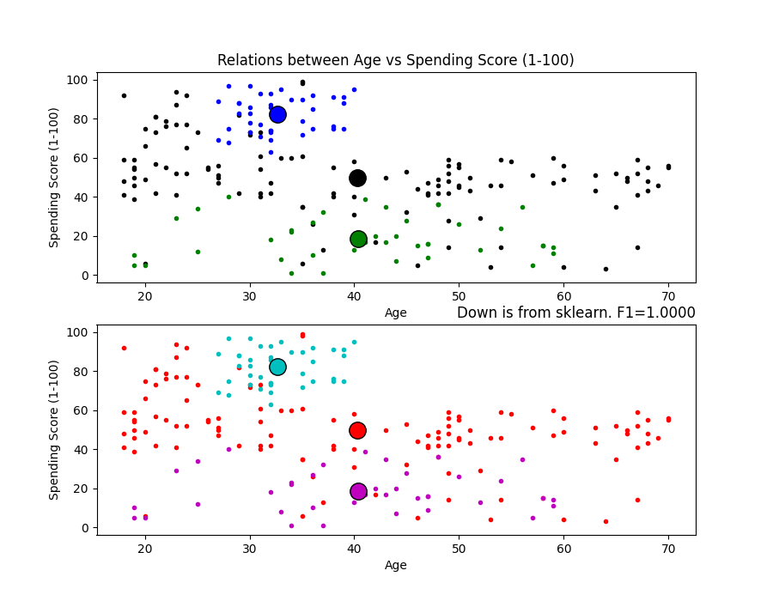
Installation and testing > Customers Data
Notes:
We can see that although the data is somewhat overlapping, the F1 score between the labels of the learned algorithm and the labels from sklearn's K-means algorithm is equal to 1. So the algorithm runs as expected.
However, as I mentioned before, the performance of the clustering algorithm is highly dependent on the initialization of the cluster center at the beginning of the algorithm. So I have to rerun a few time to have F1=1
The algorithm is initialized with k = 3. But, how can we know if the selected k is good or not? If we increase k, the elements in the cluster will be smaller, therefore, the error value will be smaller. So, just bigger is better? Although we can set k to be equal to the total number of elements in the dataset, the total error will be 0, but that doesn't seem to solve the problem because each element in the dataset will become its own center. This is called overfitting.
One way to solve the main problem is to include some penalties for the larger number of clusters. So, we're not just trying to minimize the error value, but also the error + penalty. The error will gradually converge to 0 as we increase the number of clusters, but so the penalty will increase. Balancing these two quantities will give us the optimal result. This solution is called X-means, a variant of K-means^{[14]}

Slide 15
Installation and testing > Customers Data
Notes:
Here are a few customers that have been clustered. While the upper group consists of customers with high income and spending scores, the lower group includes customers with high income but low spending scores.

Slide 16
Installation and testing > conclusion
Easy to implement
Cons
Pros
Easily adapts to new examples
Scales to large data sets.
High accuracy with separated data
Have to choose K manually
Being dependent on initial values
Inefficient for overlapping data
Notes:
The advantage of this project is that it is easy to install, and the accuracy is quite high for separate data. However, for overlapping data, the accuracy will not be high. This is a drawback of the K-means algorithm.
In addition, the algorithm also requires specifying the number of clusters and must initialize the center of each cluster reasonably in order to have a optimal result.

Slide 17
References
Tiep Vu. (2016, December 26). Bài 1: Giới thiệu về Machine Learning/Lesson 1: Introduction to Machine Learning. Retrieved from https://machinelearningcoban.com/2016/12/26/introduce/
Samuel, Arthur (1959). "Some Studies in Machine Learning Using the Game of Checkers". IBM Journal of Research and Development. 3 (3): 210–229.
Mitchell, T. (1997). Machine Learning, McGraw Hill. ISBN 0-07-042807-7, p.2.
Tiep Vu. (2016, December 27). Bài 2: Phân nhóm các thuật toán Machine Learning/Grouping of Machine Learning Algorithms. Retrieved from https://machinelearningcoban.com/2016/12/27/categories/
Nguyễn Văn Hiếu ( 2018 October 2) Hướng dẫn sử dụng thư viện Pandas trong Python/ Instructions for using the Pandas library in Python. Retrieved from https://viblo.asia/p/huong-dan-su-dung-thu-vien-pandas-trong-python-XL6lAxaDZek
Máy học cho người Việt/Machine learning for Vietnamese ( 2017 June 1) Numpy. Retrieved from https://ml4vn.blogspot.com/2017/06/numpy.html
Máy học cho người Việt/Machine learning for Vietnamese ( 2017 June 1) Bắt đầu học Scikit-learn. Retrieved from https://ml4vn.blogspot.com/2017/08/bat-au-voi-scikit-learn-cac-khai-niem.html
Nguyễn Văn Hải. Vẽ đồ thị sử dụng Mathplotlib/Plotting using Matplotlib. Retrieved from http://viet.jnlp.org/home/nguyen-van-hai/nghien-cuu/mlearning/building-machine-learning-system-using-python/chng-1-bt-u-vi-python/ve-do-thi-su-dung-mathplotlib
Han, J., Kamber, M., & Pei, J. (2011). Data mining concepts and techniques third edition. Morgan Kaufmann.
MacQueen, J. (1967, June). Some methods for classification and analysis of multivariate observations. In Proceedings of the fifth Berkeley symposium on mathematical statistics and probability (Vol. 1, No. 14, pp. 281-297).
Tiep Vu. (2017, January 1). Bài 4: K-means Clustering. Retrieved from https://machinelearningcoban.com/2017/01/01/kmeans/
ClustEval | F1-Score. (n.d.). Retrieved from https://clusteval.sdu.dk/1/clustering_quality_measures/18
Mall Customer Segmentation Data. (n.d.). Retrieved from https://www.kaggle.com/vjchoudhary7/customer-segmentation-tutorial-in-python
Pelleg, D., & Moore, A. (2000). X-means: Extending K-means with Efficient Estimation of the Number of Clusters. Carnegie Mellon University, Pittsburgh, PA.
Iliassich, L. (2016, May 19). Clustering algorithms: From start to state of the art. Toptal Engineering Blog. https://www.toptal.com/machine-learning/clustering-algorithms
Thank you for your time!

